Slide 1
P1 Induction Presentation
Welcome to all our little cherubs and our new Eastbank Families!
Notes:
Hello everyone and welcome to our Primary 1 Induction presentation. My name is Miss McBurnie and I am the Acting Head Teacher here at Eastbank Primary school for the time being. Today I am going to go over some useful pieces of information that will hopefully help and put your mind at ease for your child coming to join us as part of our Eastbank family.

Slide 2
Home + School =Success!
Strong productive home school partnerships have been proven to positively affect children’s success so it is essential we work well together
High quality communication
We will provide newsletters, progress reports and if allowed parent evenings. We are always on the other end of the phone 0141 778 6659.
Visit our school website at
www.eastbank-pri.sch.glasgow.uk
Follow us on Twitter @EastbankPri
Notes:
Here at Eastbank Primary School we work together to ensure that your child has the best school experience possible. We will keep you informed as timeously as we can and we welcome you to contact us with any questions you may have. You can contact me on the email address this presentation was sent from, via telephone call or on Twitter – you can find our twitter handle on this page. Normally we would also operate an open door policy but due to the situation with COVID, it will be an appointment only system for the time being. We also have our school website that has lots of useful information on it too.

Slide 3
Together
Eastbank
Achieves
More
Notes:
As I have already mentioned, here at Eastbank Primary we work as a team. We believe that Together Eastbank Achieves More. This includes you, our children, our staff, our partners, our learning community and our community partners.

Slide 4
Eastbank Values
Pupils, parents, staff and friends of Eastbank Primary all voted for our school values.
Our school values are:-
RESPECT
FAIRNESS
RESPONSIBILITY
HONESTY
POLITENESS
Notes:
We take our Values very seriously at Eastbank Primary and we worked with our Eastbank family to create them. They are Respect, Fairness, Responsibility, Honesty and Politeness.

Slide 5
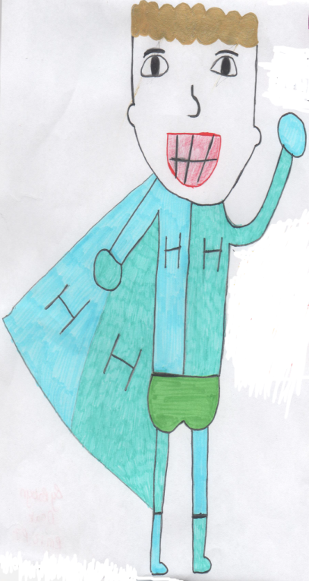
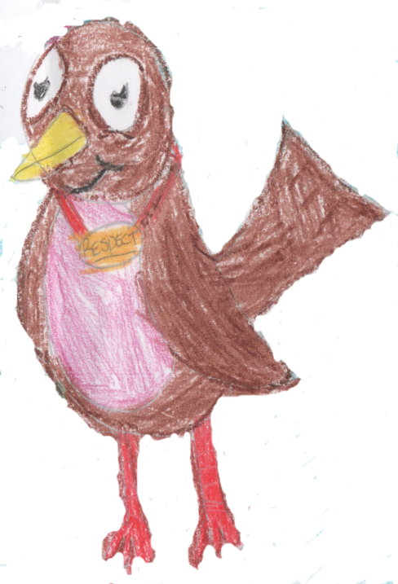
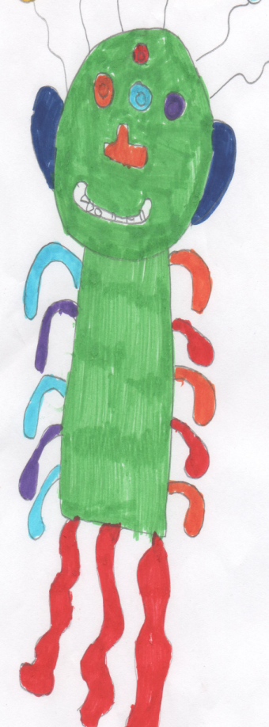
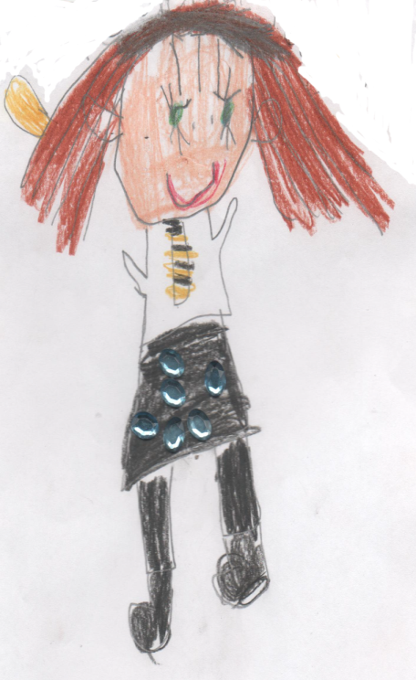
Our Values
Respect is treating everyone and everything with consideration.
Fairness is showing an awareness of all points of view.
Honesty is always telling the truth.
Responsibility is making good choices for yourself and others.
Harry
Honesty
Robin Respect
Fiona Fairness
Peter
Politeness
Rebecca Responsibility
Politeness is using good manners to live together in harmony.
Notes:
Our characters were a huge part of creating our values and we had a competition to design them, the winning designs are still used to this day.
We have Harry Honesty, who tells us that Honesty is always telling the truth.
We have Peter Politeness, who tells us that Politeness is using good manners to live together in harmony.
We have Robin Respect, who tells us that Respect is treating everyone and everything with consideration.
We have Rebecca Responsibility, who tells us that Responsibility is making good choices for yourself and others.
And we have Fiona Fairness, who tells us that Fairness is showing an awareness of all points of view.
During assemblies we talk about our values often. We chant If I say Harry, You say Honesty (the children answer with the value name used). All children are grouped into houses based on our values characters and receive tokens when they demonstrate any of our values. Our school behaviour system is tied into our values too.

Slide 6
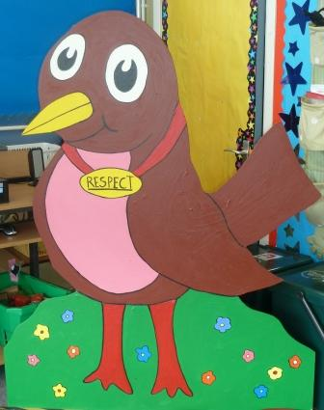
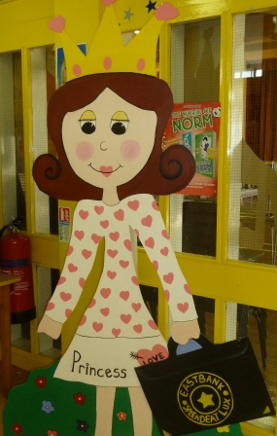
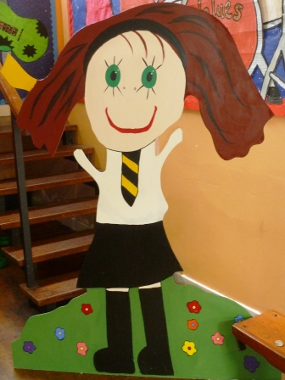
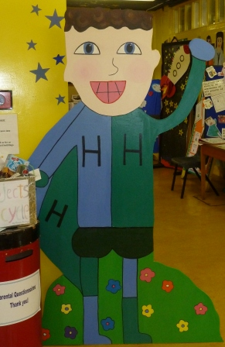
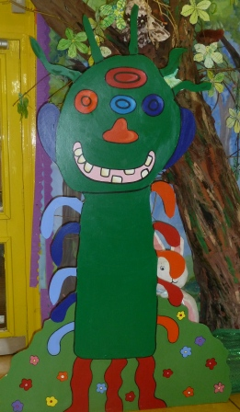
The children in the Art Council made our Values Characters from wood with the help of their teachers. Now they can be moved around the school.
Notes:
These fantastic larger than life characters can be found in our main entrance but will visit classes throughout the year too.

Slide 7
Items for school
School Uniform – all named please!!
School Uniform Website: www.border-embroideries.co.uk
School bag & pencil case - not compulsory but very helpful
Painting Overall – an old shirt/t-shirt is perfect
Gym kit – shorts, t-shirt and slip on black gym shoes
A gym bag to keep their kit in class at all times is very helpful!
Notes:
Normally we would ask for all these items to be brought to school. However, at this time all we are asking the children to bring is their lunch, if they are having a packed lunch, their water bottle and a Jacket, this is a must as we may be outside in all weathers.
Once we return to normal we will ask for these items to be brought to school. Please do ensure that ALL uniform, including lunch boxes, water bottles and jackets are named. This is essential for safety reasons but also helps your child to keep track of their things.

Slide 8
Our School Day
Important times
Due to the current circumstances the information here would vary.
*Breakfast Club will run but details will be confirmed – you will need to apply for a place*
Details of the school day will be sent out with confirmation of classes in due course ☺
A Usual P1 Day
Language Time
We will play reading games, use Big Books, practise our writing and have fun with our letter sounds
Number Time
We will investigate and explore our numbers, shapes and lots more
Topic Time
We will play with lots of activities, have arts and craft time all about our topic
Big focus on play, fun and enjoyment!
Notes:
A usual school day here at Eastbank would be working on literacy, numeracy, health and wellbeing and topic learning. This will continue as much as we can in the new term. There will be more information to follow on the timings of the day in due course.

Slide 9
Attendance and Timekeeping
Please call us if your child won’t be attending school – for the children’s safety we follow up every child who is not here by 9.30am
Medical and Dental appointments
Holidays should be arranged during official school holidays
We operate a soft start between 8.50am and 9am, you can bring your child to class to help them settle and chat to the teacher, this will really help your child! Please ensure you vacate the classroom for 9am.
Notes:
These are the usual procedures for attendance and time keeping, it is worth being aware of these. However, due to the current circumstances there will be different rules in place. This information will follow in a letter with everything you need to know for our August start.
On the first day we will ask you to arrive at 10am, however, normally there will be staggered starts with the children being dropped at the school gate. We hope that the children do not get distressed but with the best will in the world understand that this may happen. If it does we may ask you to come to the garden area with us to allow you and your child time to settle before entering the class. We will not be encouraging adults into the school during these unusual times, however, the welfare of our children is a priority for us.

Slide 10
Playtime
Adult Presence Classroom Assistants, Management Team and Janitor
Bullying Policy
Playground Games
Quiet Zone / Sheds
Notes:
We have our support for learning workers in the playground during playtime and our Leadership team is out there as often as they can be too. We will be leading socially distant games and there will only be a few classes out at a time as the breaks will be staggered too.
We have a zero tolerance approach to bullying and encourage children to treat everyone with respect. We use restorative practices to encourage the children to think about their actions and how they can ensure they choose more wisely next time.

Slide 11
Lunchtime
Every child in Primary 1 is entitled to a free school lunch
Your child can be school dinners or packed lunch
Staggered lunches
Notes:
The children who have a packed lunch at this time will eat in the classroom, only those who choose a school lunch will go to the lunch hall.

Slide 12
Eastbank Expectations
Step 1 – Verbal Warning / Stop and Think – this may include some time out within the class to think about your actions
Step 2 – Warning Card – this will be in place all day and a second one would result in a Red Card. As a result of getting a warning card you will spend 5 minutes in the Reflect and Restore Room at the start of break or lunch. During this time you will complete a think sheet. You will remain in the room until 5 minutes are up or you have completed the think sheet. ALL STAFF MEMBERS CAN ISSUE A WARNING CARD.
Step 3 – Red Card – if you receive a red card you will spend 10 minutes in the Reflect and Restore room and complete a Think Sheet
Step 4 – Zero Behaviour - Sent straight to HT/DHT/PT. This will result in a letter and/or phone call home as well as 15 minutes in the Reflect and Restore room.
Notes:
This year we developed our behaviour policy to create our Eastbank Expectations, this was extremely effective and there was a lot of success for children based around it. The approach was two pronged. One was that there were clear expectations and consequences for certain behaviours, that was fair and equal among all the children, and the second was that we celebrated those who went above and beyond in their daily actions.
Here we can see the steps that are followed consistently throughout the school when children make the wrong choices. We are aware that new Primary 1’s will need more nurture and understanding to help them become familiar with the rules and routines of school, so please don’t worry.

Slide 13
Above and beyond
On the second day the children are in – those who achieve Above and Beyond will take part in a 10 minute extra fun session within their class
Above and Beyond is for children who always show excellent manners, who are polite, helpful and respectful, who demonstrate respect for all within the school and who follow the school values even more than just behaving as they should.
Notes:
The second prong is the celebration of getting Above and Beyond, the children responded so well to this and loved it when they were celebrated for their positive choices.

Slide 14
Eastbank Play Team
Class Teachers
Learning Zone Activities
Teaching Table Activities
Play sessions
Modelling
Scaffolding
Tracking
Observing
Target Setting
Support for Learning Workers
Activities
Play sessions
Modelling
Scaffolding
Observing
Learning Environment
Acting Head Teacher
Outside Agencies
Glasgow Play Resource Association
WithKids Observational Training
University of Strathclyde
CREATE4EAST MUSIC
PEPASS P1 and P2 Physical Literacy
Child Development Officer
Stay and Play Parent Group
P1 Transition Planning / Meetings
Responsibility for planning areas
Notes:
These are all the people involved in making our P1’s experience a rich learning environment. Our class teachers provide the right learning at the right time for our children, whether it is teacher led, teacher directed or child led. Our CDO supports the development of play through their expertise of early years. Our SfLW support the children to learn in a variety of ways and our Outside Agencies support the development of our staff.

Slide 15
P1 Play Pedagogy Why Play?
Children learn so much from play; it teaches them social skills such as sharing, taking turns, self discipline and tolerance of others.
Children’s lives are enhanced by playing creatively and by playing children learn and develop as individuals; it assists in their emotional and intellectual development and mental health resilience which are core building blocks for their transition years.
Play is the universal language of childhood.
It is through play that children understand each other and make sense of the world around them.
Play is the spice of life’ – where spice represents children’s social, physical, intellectual, cultural and emotional development.
Notes:
Here at Eastbank we use the playful pedagogy approach. This ensures a smooth transition from nursery, that all children are engaged, that all children are actively learning, that we respond to the interests of the child and that children are able to lead their learning through personalisation and choice. It is said that Scientists have recently determined that it takes approximately 400 repetitions to create a new synapse in the brain - unless it is done with play, in which case it takes between 10 and 20 repetitions.
Primary 1 will start their Baby Strings journey with the creation of a paper orchestra and we are working on how to do this best with our Baby Strings tutors.
While not all of these activities will take place at the start of the year we will get them up and running as soon as possible. We will be encouraging play as much as we can by rotating resources and allowing children to have access to their own resources.

Slide 16
Learning Environment/Ethos
Accessible and labelled resources
Vocabulary Rich Environment
Provocations
Nurture
Family Learning
Withkids
CLOL Literacy Hero’s
CLOL Play along Maths
Craft and Chat
CDO Stay and Play
Multi Sensory Shared Home Learning
Soft Start
Family relationships
Nurture
How do we Play?
Learning, Teaching and Assessment through Play
ZONES
Classroom Must Do’s
Construction
Cooking
Creative
Loose Parts Play
Outdoor Garden
Outdoor Play
STAR Hotel Stage
STEM
Teaching
Child led activities
Responsive planning
Small group teaching table
Independent learning zones
Must Do Tasks
Plenary
Assessment
Observation
Learning journeys
Floorbooks
Notes:
These are just a few of the valuable tools that play allows us to take advantage of and we look forward to opening up our play more fully, however, we are still able to meet many of these targets in a more restricted setting. We will be asking our CDO to create some play videos for you to copy at home.

Slide 17
Supporting your child’s learning
Find time to chat about the day, what they’ve enjoyed and learned
Children love books even long before they can read – share stories and books, talk about the pictures and run your finger along the words as you read them to your child.
Encourage all sorts of writing and drawing – it doesn’t have to be perfect!
Use the numbers all round us in our everyday life – counting birds or pointing out shapes and colours all help your child to learn.
The homework your child will receive should be positive time for them to show you what they can do and a nice time to spend together!
Notes:
There will be three days the children will be at home carrying out work covered by the teacher during their face to face learning but there are lots of other ways you can help too. Being actively engaged in talking about your child’s work will allow them to make connections while retelling it to someone else, this is often a valuable way to embed learning and create transferrable links.

Slide 18
Medication/illness during School
Importance of Emergency Contacts form!
Written instructions must be provided for any medicines you wish your child to take during school
Primary 1 medical checks
Hair Hygiene
Notes:
Please ensure you complete these invaluable forms for us so that we can keep your children safe and well. Thank you for submitting relevant information so far. We are unsure how the P1 medical checks will happen this year but we will keep you well informed when we do. Please check your child’s hair regularly and carry out the full necessary hygiene treatment. Should your child fall ill during school we will contact you to collect them, we have procedures in place should they develop symptoms of COVID. Please do not send your child to school if they are displaying any symptoms at home.

Slide 19
How can you get involved at Eastbank Primary?
Helping out with activity times
Attending family learning sessions
Supporting with shared home learning
Volunteering to attend school trips
Responding to letters and Twitter campaigns
Attending our events and assemblies
Engaging with Seesaw
Parent Council
Notes:
We have a fully involved Parent Council that you are welcome to join, though at this point in time we will not have anyone coming in to the school. Once that changes we would value your help and assistance.
For now you can help with shared home learning, support your child with Seesaw, tweet clips of your child involved in their learning and ensure you let us know if there is anything you need.

Slide 20
Best Start Grant
A one off cash payment for school age of £250 per child
Between 1/3/15 - 29/2/16 = Apply 1/6/20 – 28/2/21
You must be receiving one of these (you can be in work):
Child Tax Credit / Universal Credit / Income Support / Pension Credit / Working Tax Credit / Housing Benefit / Income based JSA / Income related ESA
https://www.mygov.scot/benefits/best-start/
Notes:
The Best Start Grant is a £250 payment made around the time a child normally starts Primary 1 to help with the costs of a child starting school. This money can be used for anything that families may need at this key stage in a child’s life. Applications will open on 1 June 2020 until 28 February 2021 for children who were born between 1 March 2015 and 29 February 2016. The link can be found on this page.

Slide 21
Glasgow City Council
Please visit this link for the most up to date information from Glasgow City Council, including application for key worker care for the summer
https://glasgow.gov.uk/article/25947/Recovery-Resilience-and-Reconnection-2020

Slide 22
Something to ponder on …
Expect children to be better than they are; it helps them to become better.
But don’t be disappointed when they are not; it helps them to keep trying.
Merry Browne

Slide 23
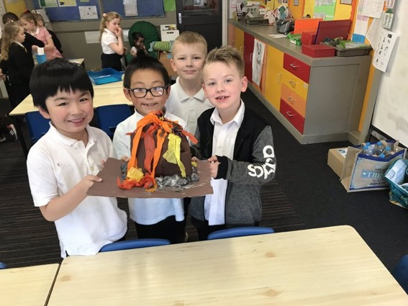
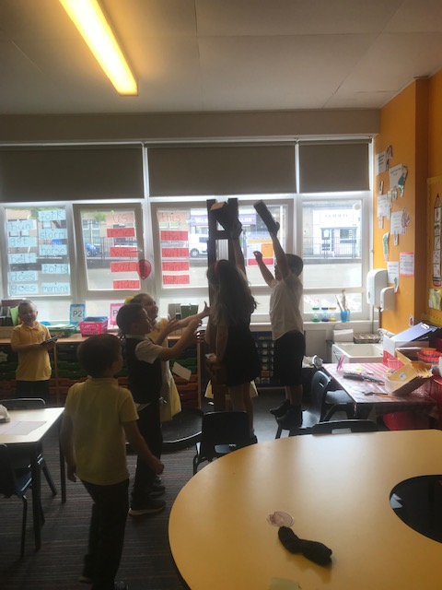
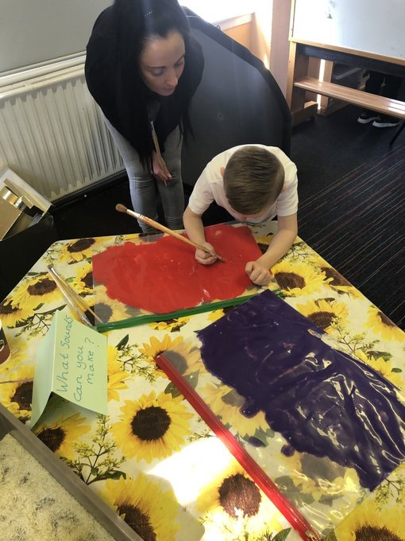
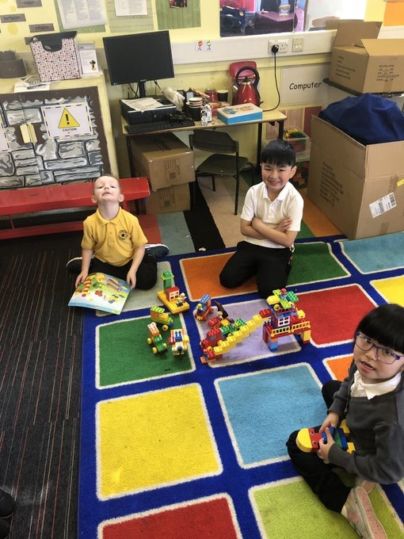
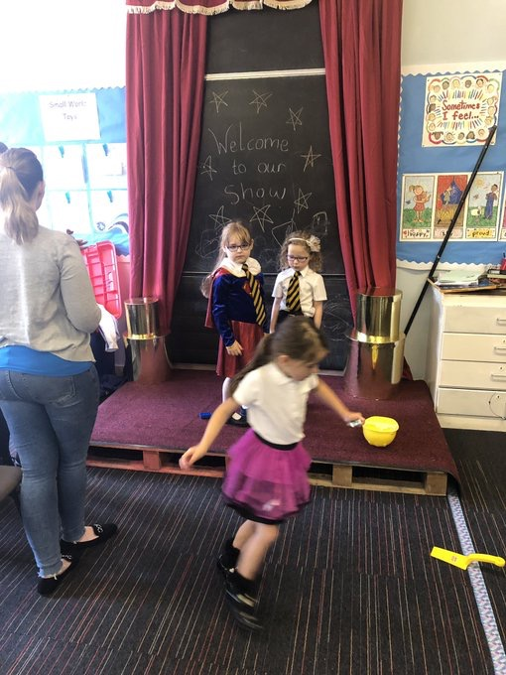
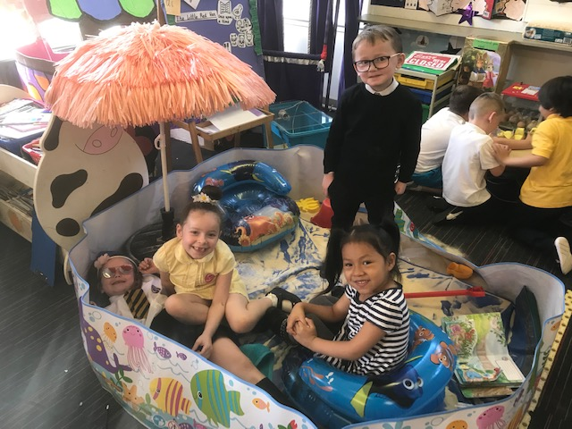
Notes:
Thank you so much for listening and I hope this helps you with some of the questions you may have had. More information will follow in regards to the finer points of returning in August for the whole school.

